Slide 1
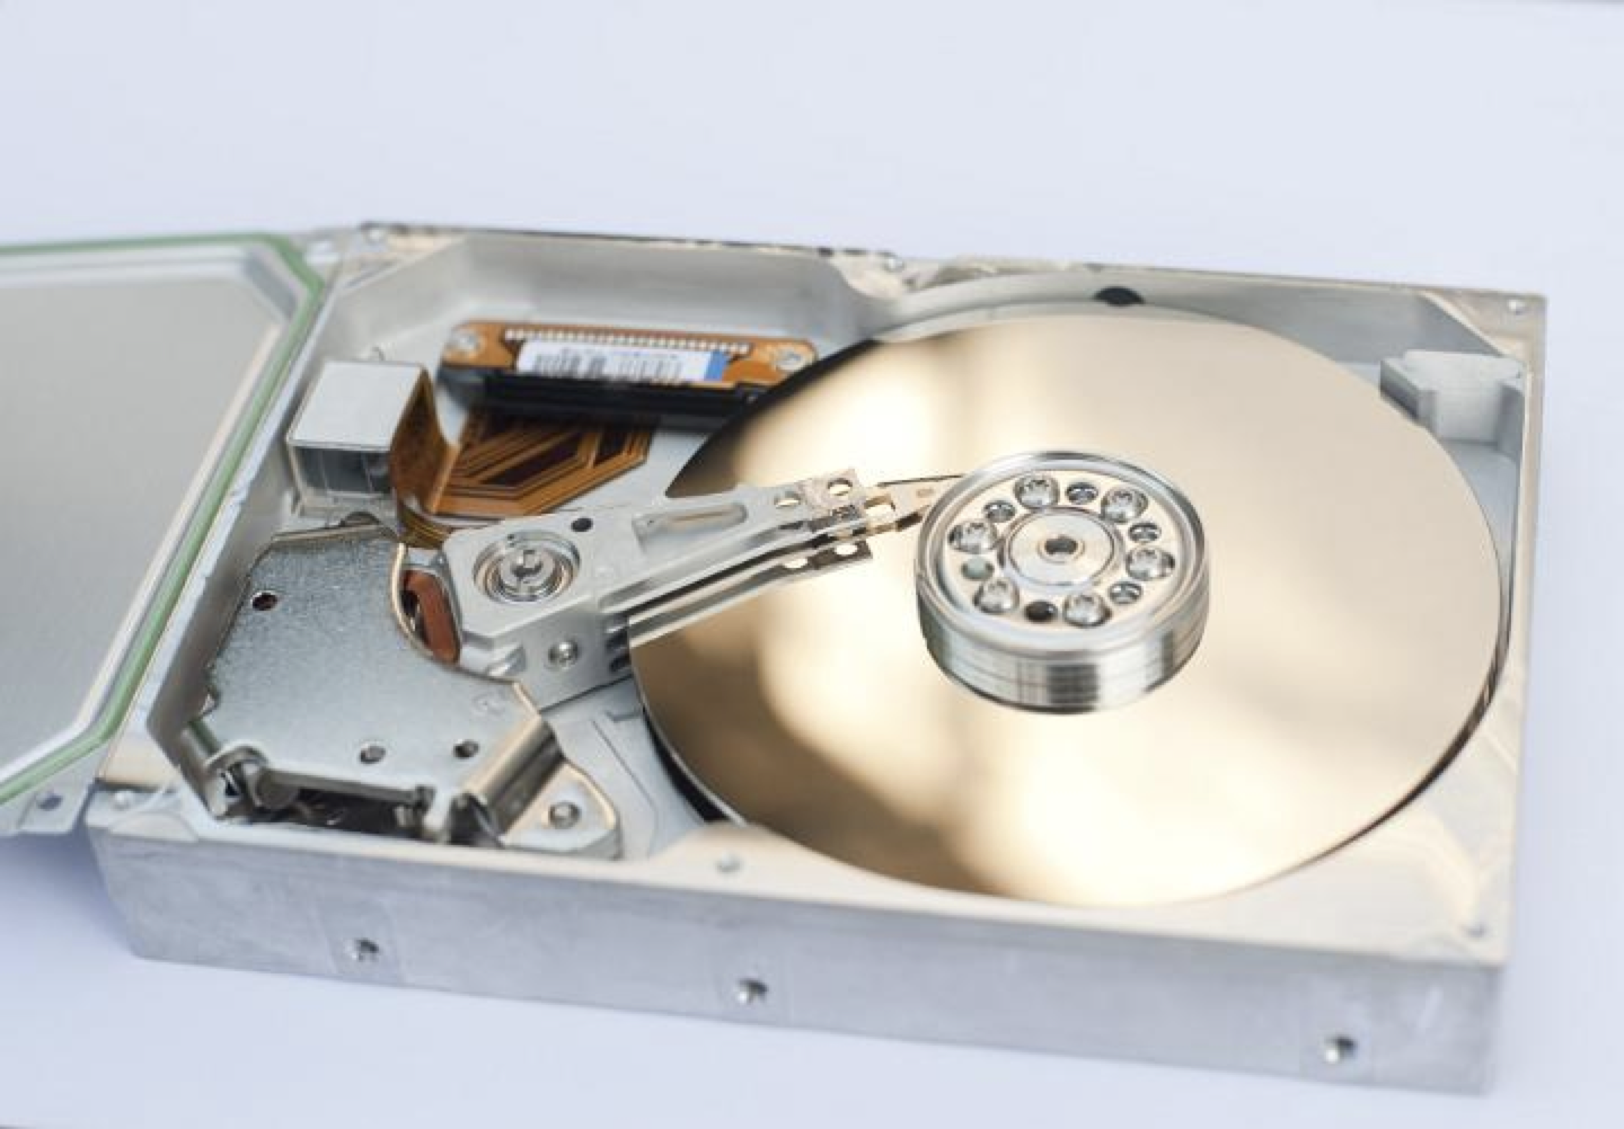
Industrial Machine Learning on Hadoop and Spark
Maks Nakhodnov, Bremen 2025

Slide 2
Distributed computing. Introduction
Plan:
What is big data, and where does it come from?
Industries generating big data. Data explosion.
Big data – the starting point. 5 main principles.
How companies handle big data: IaaS / PaaS / SaaS.

Slide 3
Industries generating big data. Data explosion.

Slide 4
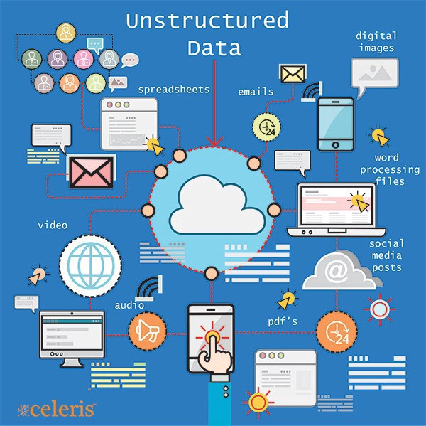
Origins of Big Data
Industries:
Telecom
Banking
Social networks
Media
Industry
Bioinformatics
Internet of Things (IoT)

Slide 5
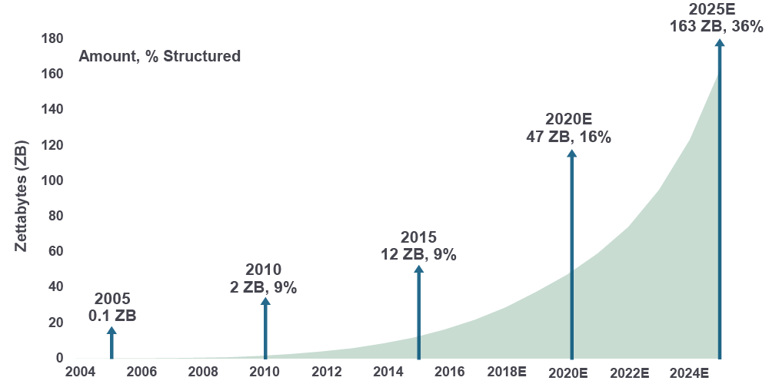
Data explosion
One zettabyte equals one trillion gigabytes.
1 kilobyte | 1 000
1 megabyte | 1 000 000
1 gigabyte | 1 000 000 000
1 terabyte | 1 000 000 000 000
1 petabyte | 1 000 000 000 000 000
1 exabyte | 1 000 000 000 000 000 000
1 zettabyte | 1 000 000 000 000 000 000 000

Slide 6




Processes 20Pb per day (2008) Downloads 20B web pages per day (2012)
>10 PB data, 75B DB (6/2012)
>100 Pb user data + 500 TB/day (8/2012)
S3: 449B objects (7/2011)

Slide 7
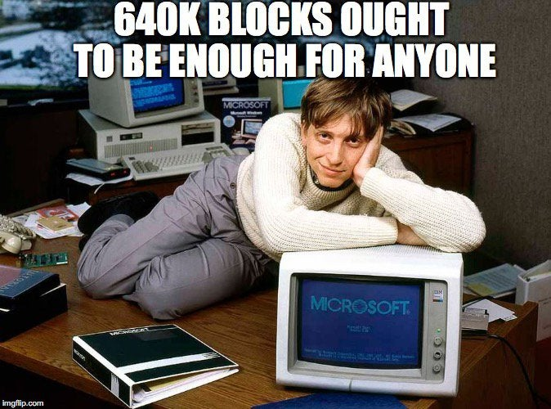
How much is “big data”?

Slide 8

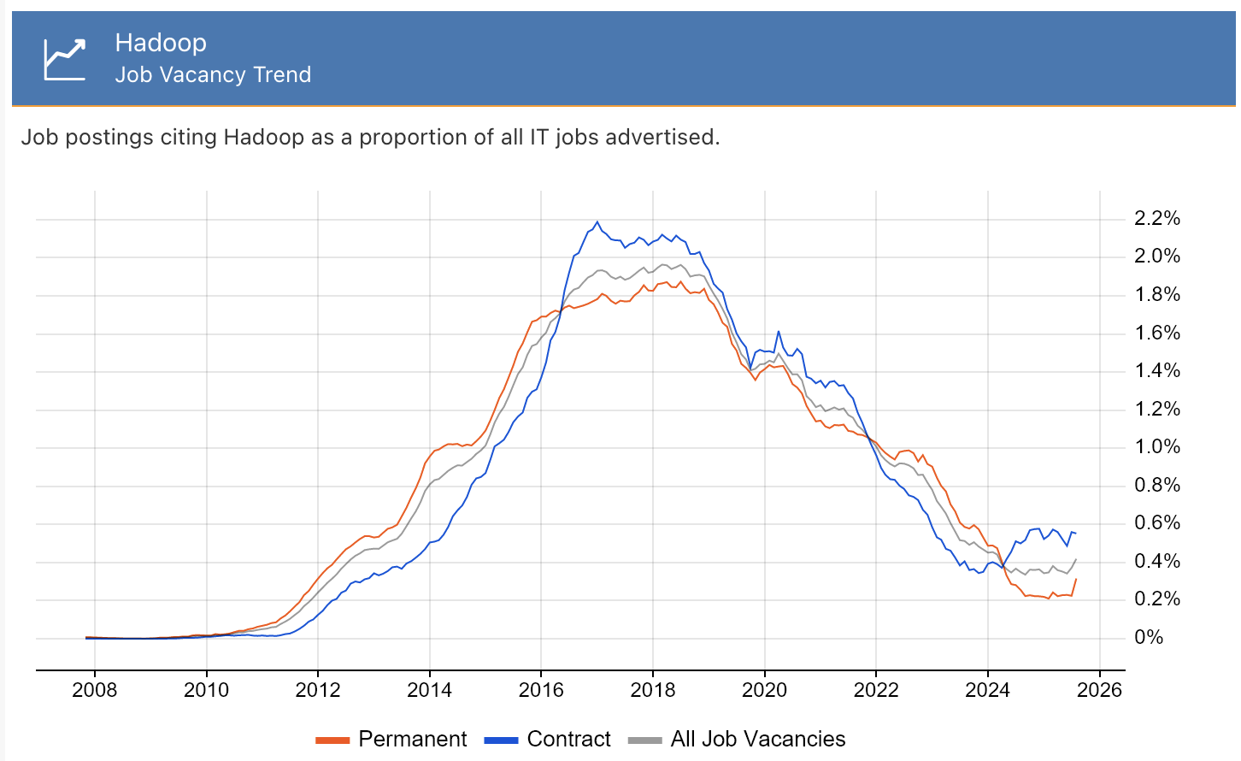
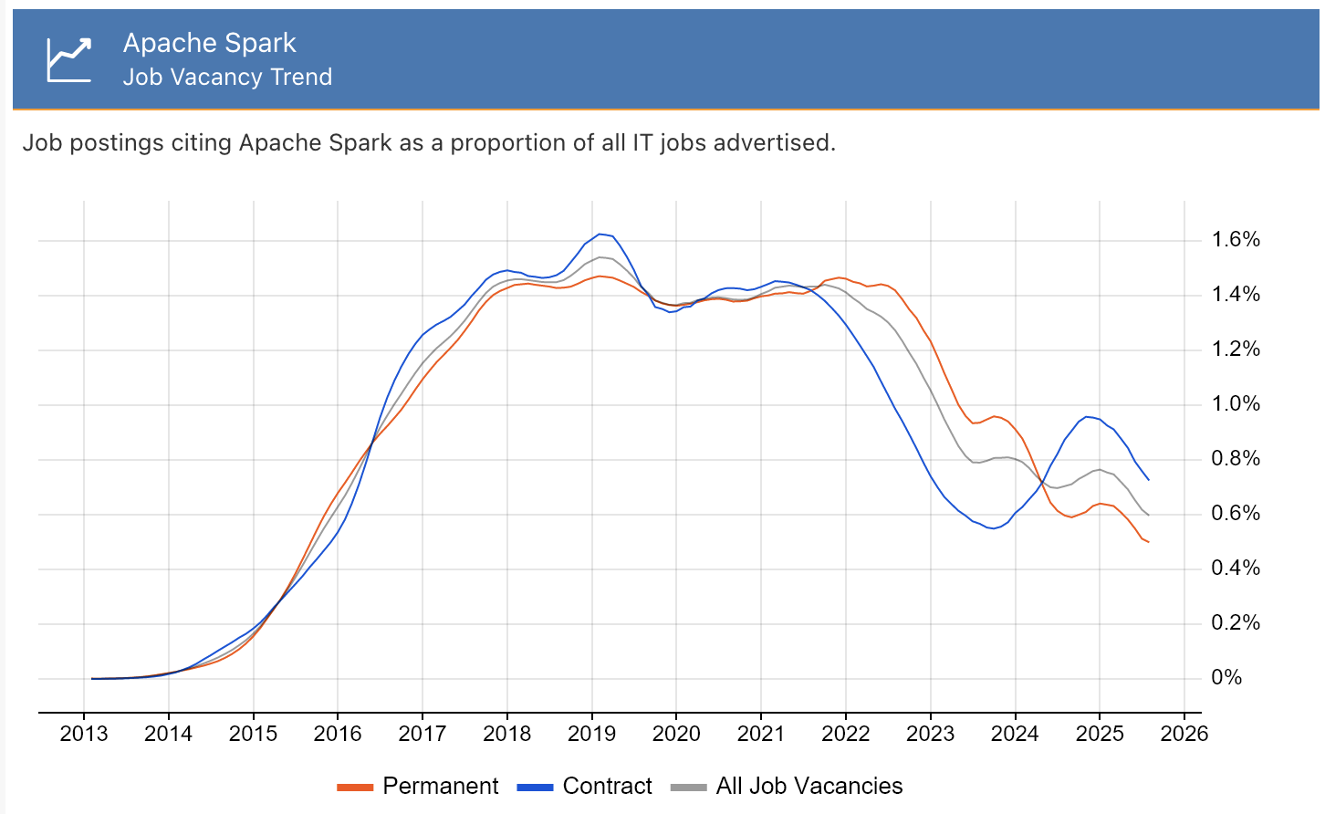
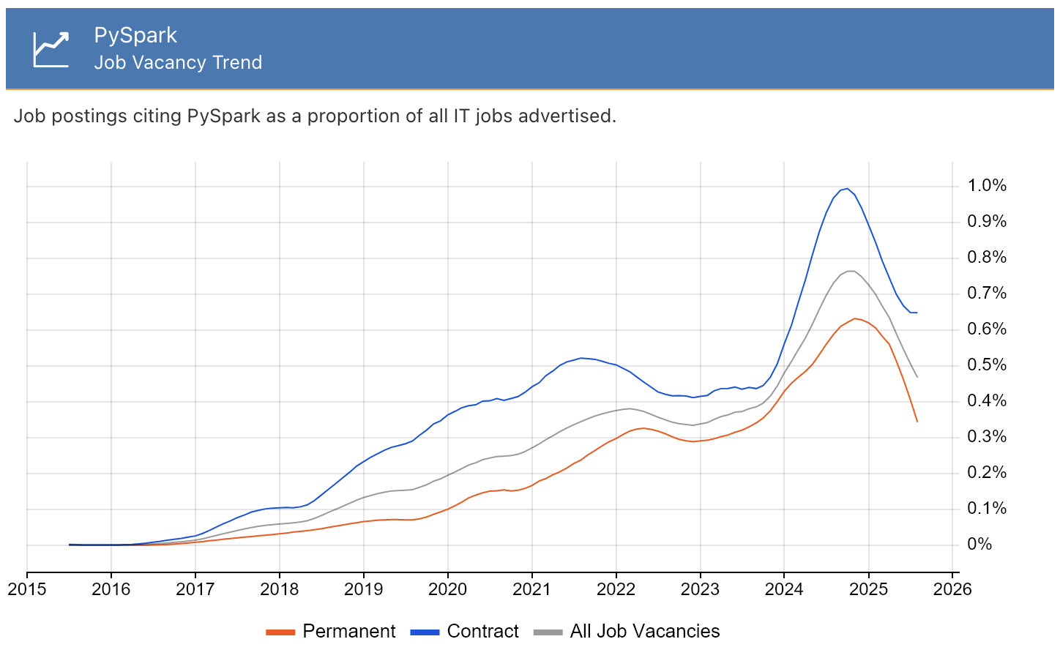
Job trends
Source: https://www.itjobswatch.co.uk/jobs/uk/

Slide 9
Big data – the starting point. 5 main principles.

Slide 10
Big data – 5 main principles
Value
Volume
Veracity
Insight
Accuracy
Impact
Terabytes
Records
Transactions
Tables, files
Velocity
Variety
Tweets
Facebook posts
Device sensors
Video
Audio
Text data
Time series
Data generation speed
Generated in real-time
Online and offline data
In streams, batches, or bits
Structured
Unstructured
Semi-structured

Slide 11
How do companies handle big data?

Slide 12
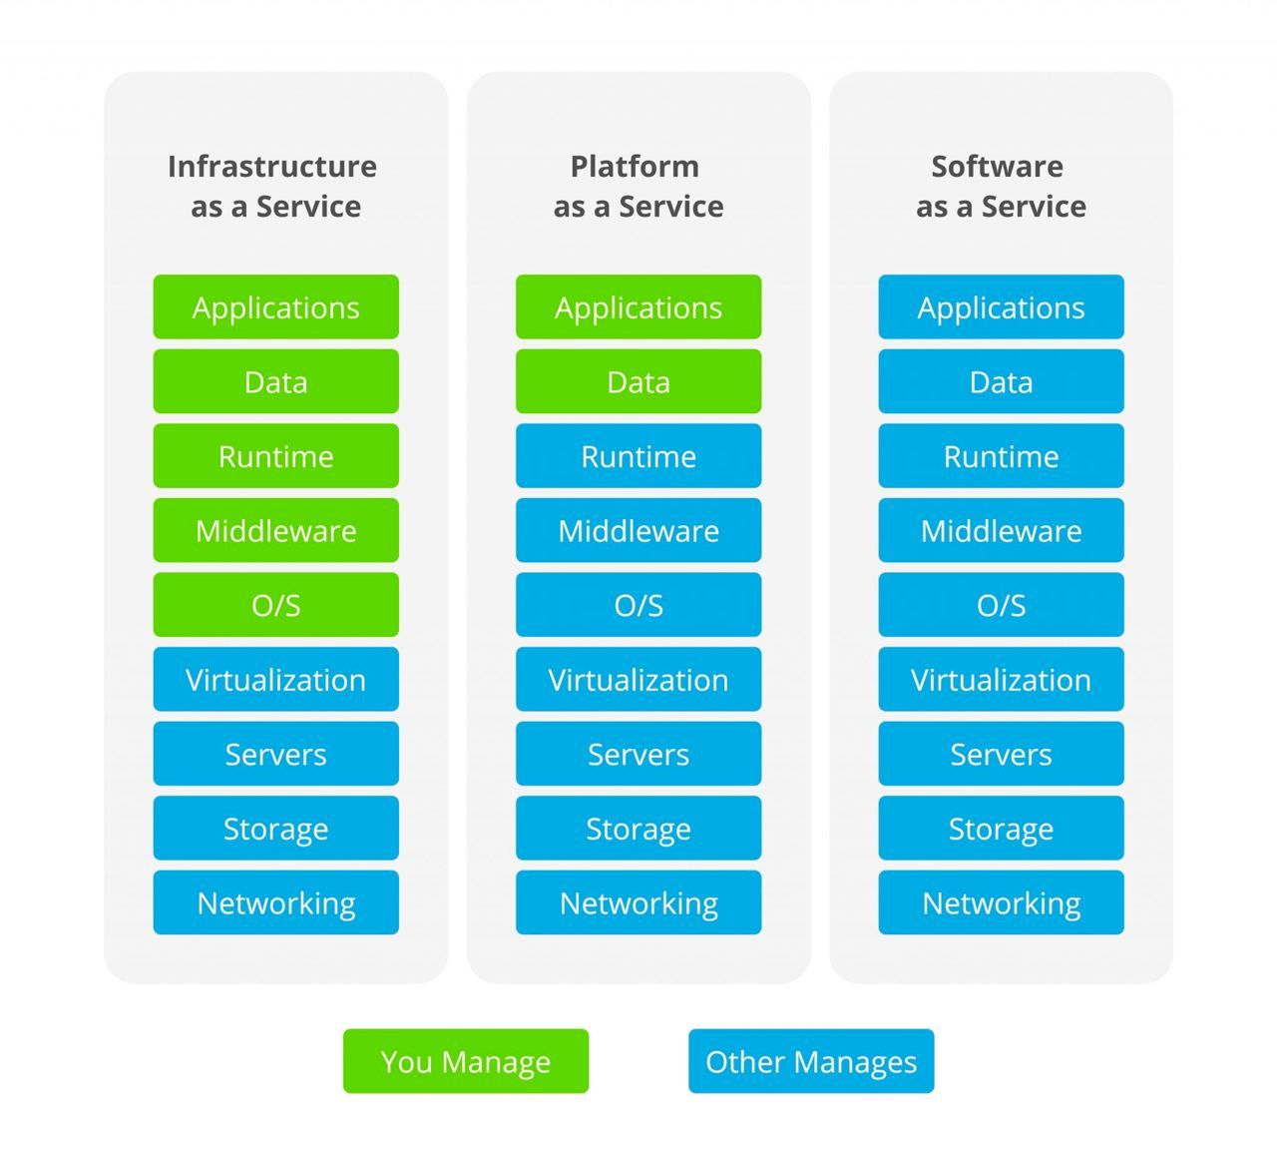

Slide 13
IaaS — Infrastructure as a Service. Provides infrastructure resources such as virtual servers, storage, and networks (Google Compute Engine, DigitalOcean, Amazon Web Services (AWS), Cisco Metacloud).
Migrating IT systems to the cloud
Saving on infrastructure costs
Rapid business launch
Scaling infrastructure
Infrastructure for companies with demand spikes
Development and testing
PaaS — Platform as a Service. Provides a platform for building and deploying applications (Windows Azure, OpenShift, Heroku, Google App Engine).
Databases
Application development in containers
Big data analytics
Machine learning
SaaS — Software as a Service. Provides software applications as a service (Google App Engine, Dropbox, JIRA).
Email
CRM systems
Task planners
Website builders

Slide 14
The first key question: how to store big data?

Slide 15
Filesystem
The main functions of a filesystem are:
Storing and organizing data on a storage device as files
Determining the maximum supported data volume on the storage device
Creating, reading, and deleting files
Assigning and modifying file attributes (size, creation and modification time, owner and creator, read-only, hidden, temporary, archive, executable, maximum filename length, etc.)
Defining the structure of a file
Searching for files
Organizing directories for logical file organization
Protecting files in case of system failure
Protecting files from unauthorized access and modification

Slide 16
Linux File System Directories
/mnt: Where you mount other things Network locations and some distros, you may find your mounted USB or DVD.
/opt: Some optional packages are located here and managed by the package manager.
/proc: Because everything on Linux is a file, this folder for processes running on the system, and you can access them and see much info about the current processes.
/root: The home folder for the root user.
/sbin: Like /bin, but binaries here are for root user only.
/tmp: Contains the temporary files.
/usr: Where the utilities and files shared between users on Linux.
/var: Contains system logs and other variable data.
/bin: Where Linux core commands reside like ls, mv.
/boot: Where boot loader and boot files are located.
/dev: Where all physical drives are mounted like USBs DVDs.
/etc: Contains configurations for the installed packages.
/home: Where every user will have a personal folder to put his folders with his name like /home/likegeeks.
/lib: Where the libraries of the installed packages located since libraries shared among all packages, unlike Windows, you may find duplicates in different folders.
/media: Here are the external devices like DVDs and USB sticks that are mounted, and you can access their files from here.

Slide 17
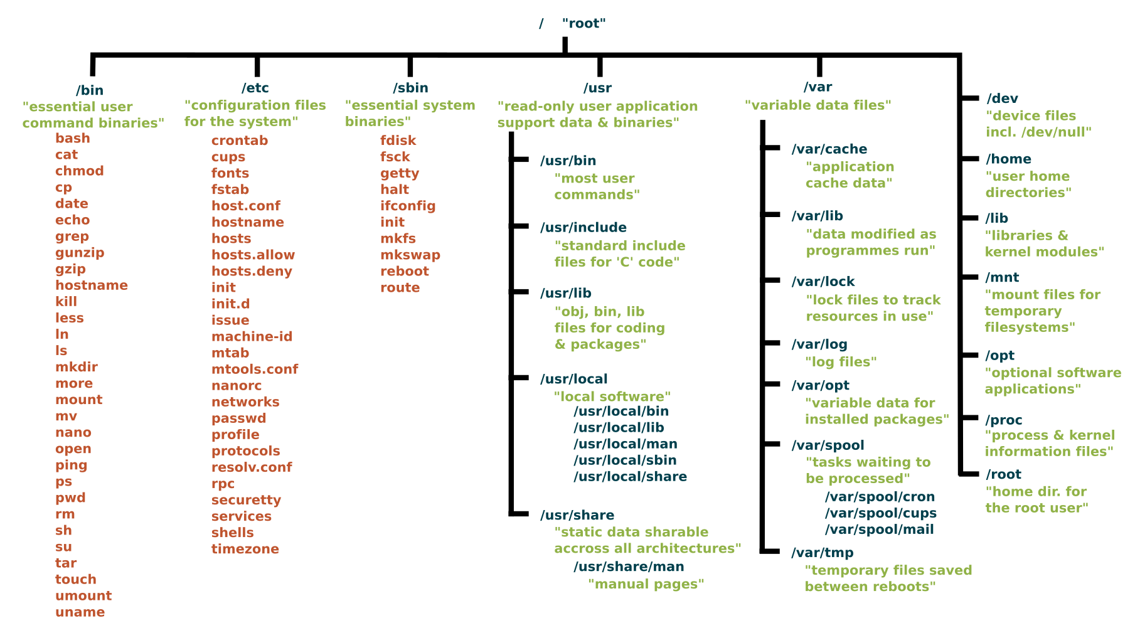

Slide 18
Fault tolerance in data storage and computation

Slide 19
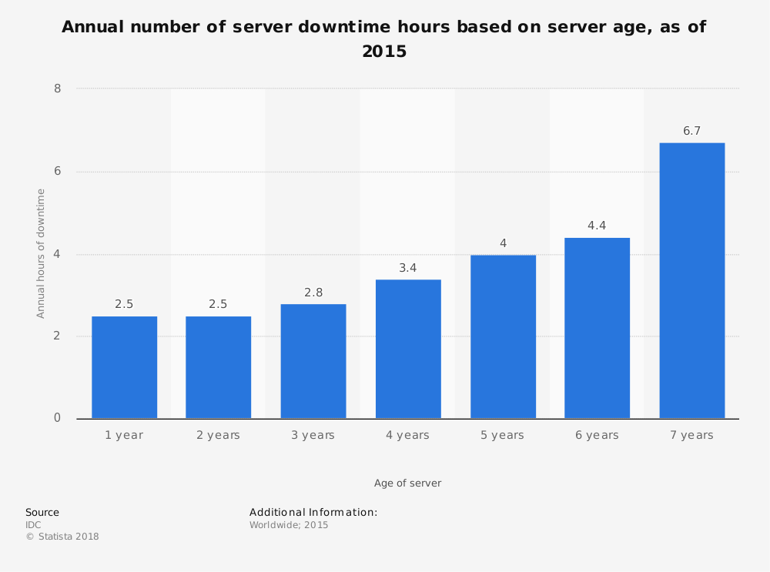
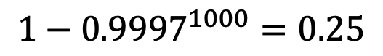
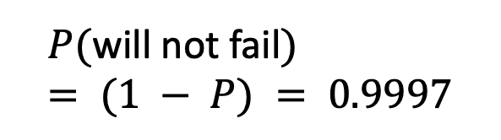
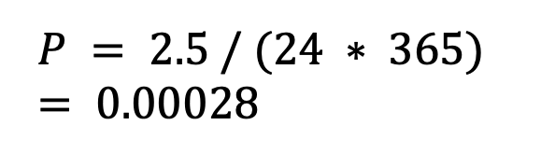
The probability that a failure will occur in the next hour:
$$P = 2.5 / (24 ∗ 365) = 0.00028$$
$$P(\text{will} \text{not} \text{fail}) = (1 − P) = 0.9997$$
A cluster of 1000 machines
The probability that one of the servers will fail in the next hour:
$$1−{0.9997}^{1000}=0.25$$

